Slide 1
Chapter 10
Strategies for Web Auctions, Virtual Communities, and Web Portals
Electronic Commerce

Slide 2
Auction Basics
English Auctions
  Bidders publicly announce their successively higher bids until no higher bid is offered
  Minimum price can be used to set the price at which the auction will begin
  Reserve price is the minimum price the seller will accept
  Yankee auctions allow the bidder to choose the quantity of multiple items offered at the auction

Slide 3
Auction Basics
Dutch Auctions
  Form of open auction in which bidding starts at a high price and drops until a bidder accepts the price
  Usually the seller offers a number of similar items for sale
  Good for moving large numbers of commodity items quickly

Slide 4
Auction Basics
Sealed-Bid Auctions
  Bidders submit their bids independently and are usually prohibited from sharing information with each other
    First-price sealed-bid
      Highest bidder wins
    Second-price sealed bid
      Highest bidder wins, but at the second-highest bidder’s price
      Encourages all bidders to bid their private valuations, reducing collusion

Slide 5
Auction Basics
Double Auctions
  Buyers and sellers each submit combined price-quantity bids to an auctioneer
  The auctioneer matches the seller’s offer (lowest price, then up) to the buyer’s offers (highest price, then down)
  New York Stock Exchange conducts sealed-bid double auctions of stocks and bonds

Slide 6
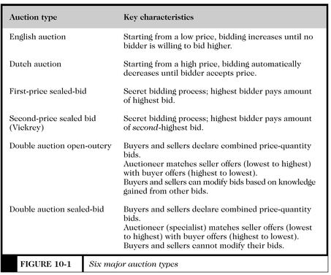
Six Major Auction Types
Figure 10-1

Slide 7
General Consumer Auctions
eBay
  Search for specific items
  Browse by categories of items
  Seller options include bold-face type and featured listings
  Rating system to provide feedback to alleviate fears concerning seller reliability

Slide 8
Additional General
Consumer Auctions
Auction Universe, owned by Classified Ventures, a partnership of eight major newspapers
  Apartments.com
  Cars.com
  NewHomeNetwork.com
Yahoo! and Excite have created auctions based on the eBay model

Slide 9
Business-to-Business Auctions
Typically used to dispose of excess inventory
Large companies use liquidation specialists to find buyers for unusable inventory, create their own auction sites
Smaller companies often sell their excess inventory to liquidation brokers, who, in turn, create auction sites

Slide 10
Seller-Bid Auctions and
Group Purchasing Sites
Reverse auctions
  Sellers of goods and services bid the prices at which they are willing to sell
Group purchasing sites
  Items are posted with a price, as the number of bids increase, the seller negotiates a better price with the item’s provider

Slide 11
Virtual Community Strategies
Gathering places for people and businesses that does not have a physical existence
  Usenet newsgroups
  Chat rooms
  Web sites
Helps companies, customers, and suppliers plan, collaborate, transact business, and interact in a mutually beneficial way

